Slide 1
Reinforcement Learning

Slide 2
Many routes to learn RL
The route we will take is the one that I took, but could be others
Part 1: Tabular Q Learning
Q tables, dynamic programming ish approach
Deep q learning for discrete action spaces
Part 2: Policy Learning, naturally suggest deep learning
Deep Policy Learning
Part 1 + Part 2 : Soft Actor Critic Model

Slide 3
Two ways to learn to play
Q learning
You define a Q function or a Q-table
This table tells you the payoff from each state-action pair
(e,e,1,1,pi,0) – you are epsilon distance away from the ground with low speed you would get pay offs from all the actions (fire right, fire left etc)
You would then choose the maximum
Policy learning
Policy is a function that tells you what to do in each state
Using some gradient method learn the policy function over multiple iterations of the game

Slide 4
Q-Learning

Slide 5
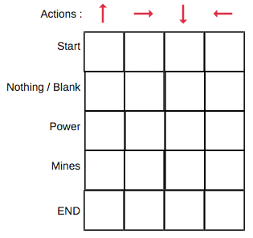
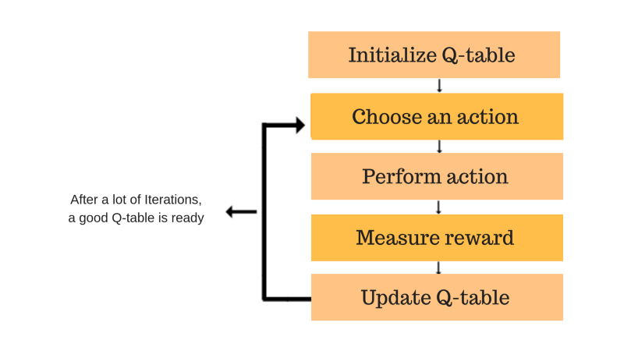
Q-Learning via Tables
Optimized using the Bellman equation
Ideal value :
Q(s,a) = r + gamma max(Q(s’,a’))
If the Q table was good, it would be exactly the current reward plus the maximum possible reward by taking the best possible action next a’
Update rule – Q(s,a) + alpha * (Ideal value – Q(s,a) [stability]
Cons:
This table can be quite massive
Impossible for continuous spaces
For continuous action spaces, small changes have less importance

Slide 6
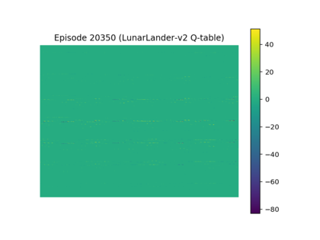
Q Learning in Lunar Lander
Crazy, but you can discretize the whole state and action space of the game using buckets
Horizontal streaks suggest that for certain states certain thruster values
Not sure about axes here (just for representation)

Slide 7
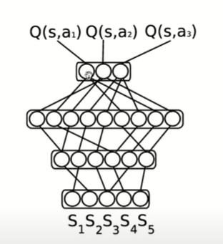
Q Learning via Functional Approximations
Instead of using a table, you can create a function that approximates the pay off
For some complex and continuous description of states S
You can get a value function for each action a
We can now have continuous state spaces, but we can also efficiently represent large discrete state spaces
Cons:
Actions must be discrete

Slide 8
Policy Learning

Slide 9
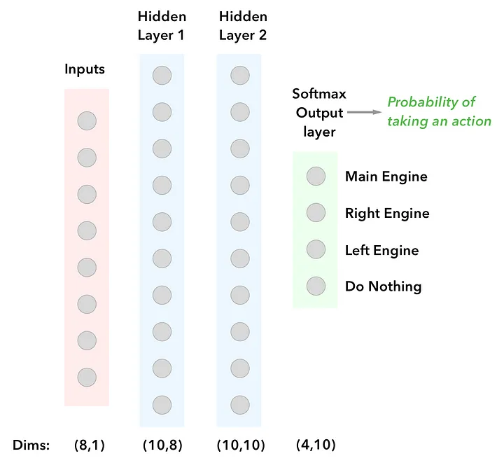
Policy Learning
More popular than Q-learning
A policy tells you what to do in each state update it directly
Think of state as a continuous vector, in the case of lunar lander it is just pixel wise input
pi(a|s) is a policy function
The loss function multiplies the observed rewards for an action with the probability of that action

Slide 10
Why not both?
Soft Actor Critic model

